Slide 1



Mars rover
By: Alvarado, Georgian, Weikun, yang

Slide 2

TOPICS COVERED
APPROACH
TIME VS ACCURACY
TEMPERATURE
DHT-11
PI
IMPROVE SENSOR PERFORMANCE
CONCLUSION

Slide 3
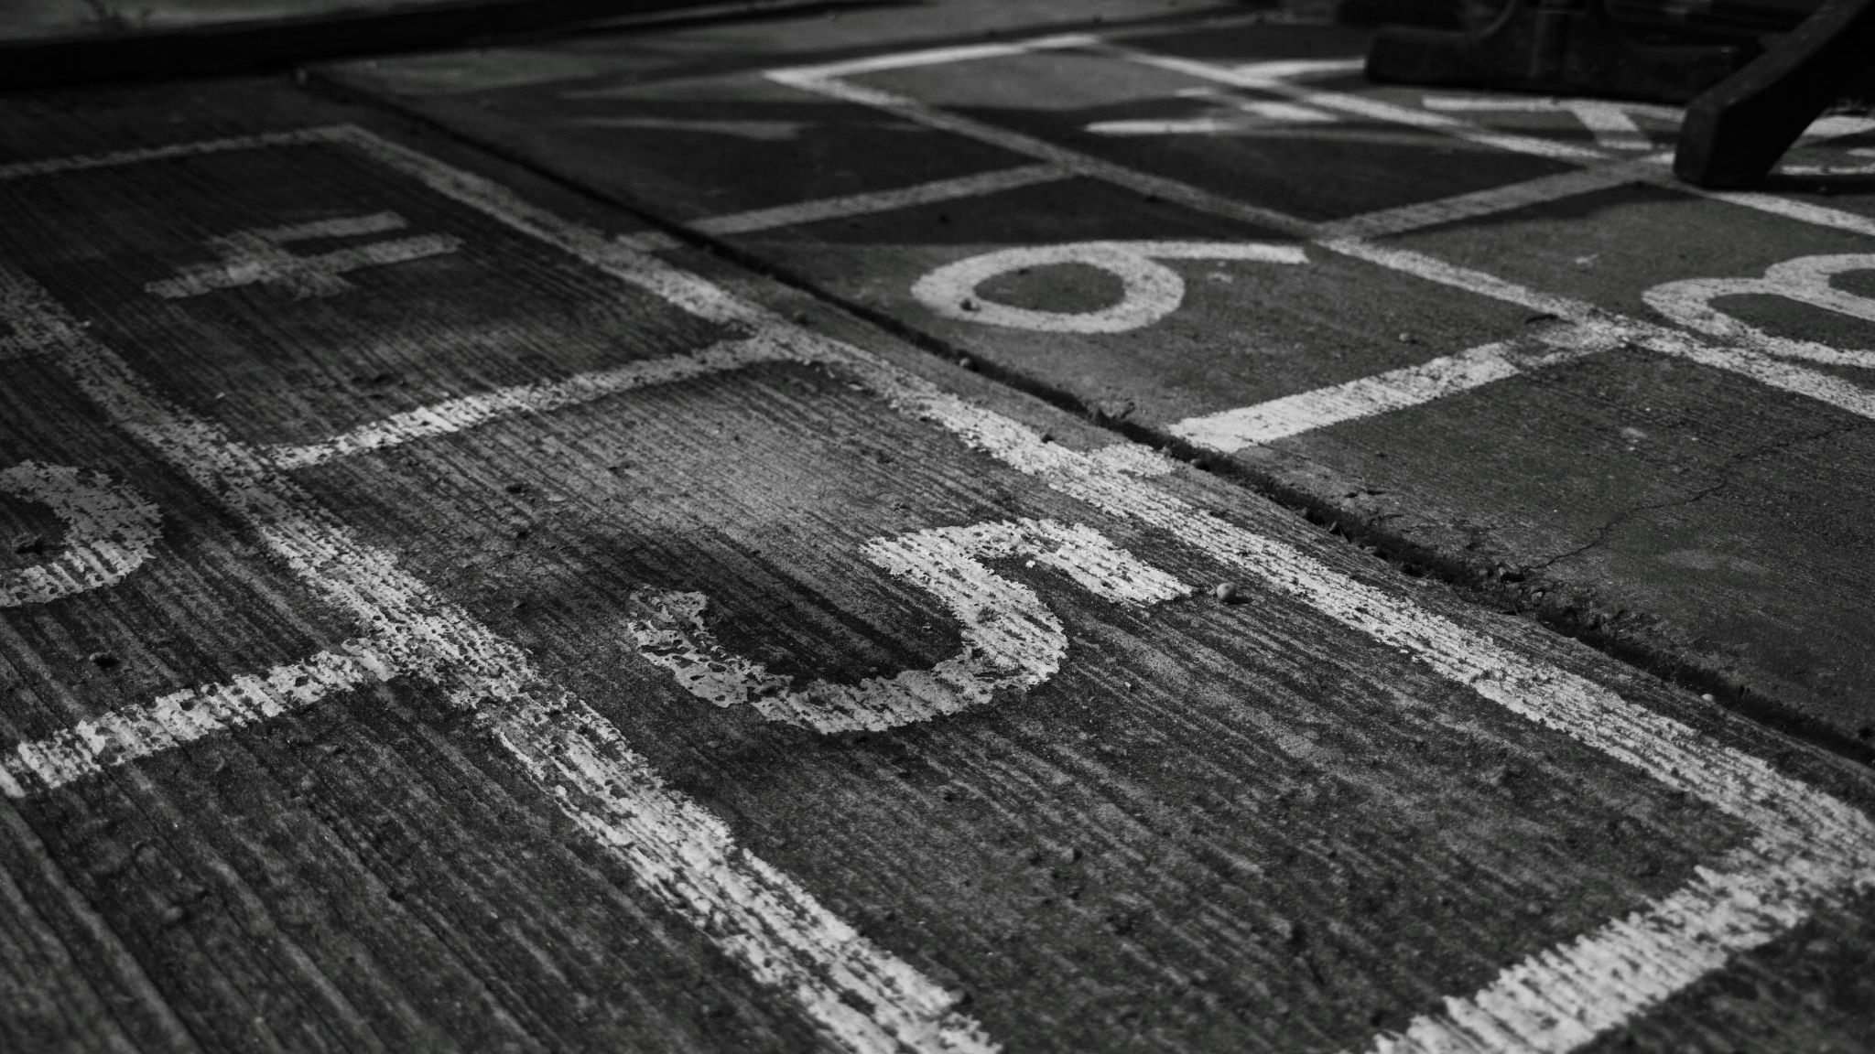
APPROACH
FOCUSED ON FUNCTIONALITY
CONSIDERATION OF SENSORS
INTEGRATION WITH DHT
ACCURACY AND PRECISION OF DATA
IMPROVEMENTS WITH MOBILITY

Slide 4
APPROACH DESCRIPTIONS
1) FUNCTIONALITY: Ensuring the rover can move and operate along a pre-determined waypoint mission.
2) SENSOR: Determining which sensor could be integrated easily and have an obtainable ground for comparison.
3) DHT INTEGRATION: Utilizing micro-SD card to capture and export data from Arduino.
4) ACCURACY/PRECISION: Fine tuning the performance of the rover and its sensors to obtain the most precise and accurate data.
5) IMPROVE MOBILITY: Adjusting PID to provide quicker waypoint timing and waypoint accuracy.

Slide 5
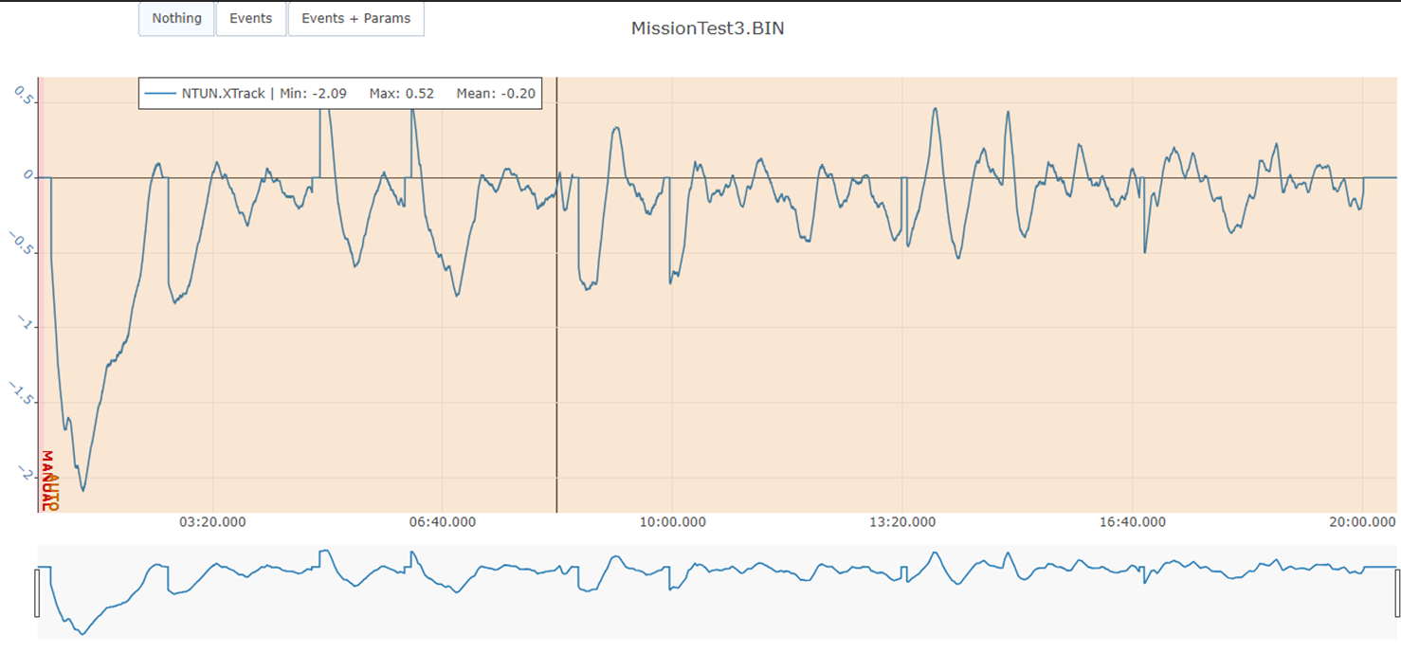
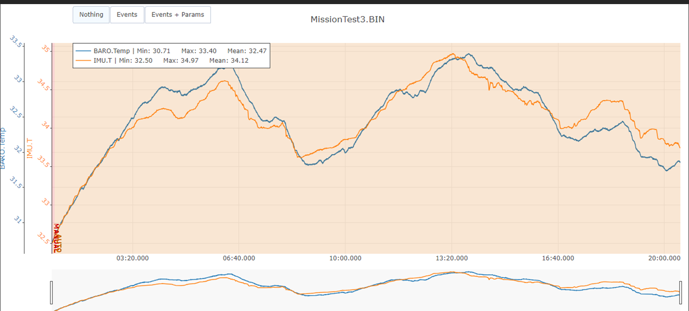
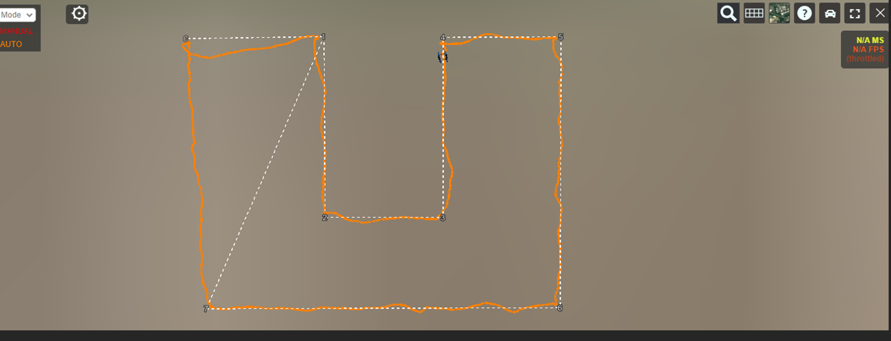
Initial DATA

Slide 6

TIME VS ACCURACY
Accuracy of the path was chosen over a faster time.

Slide 7
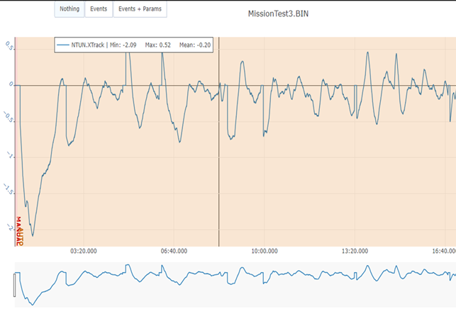
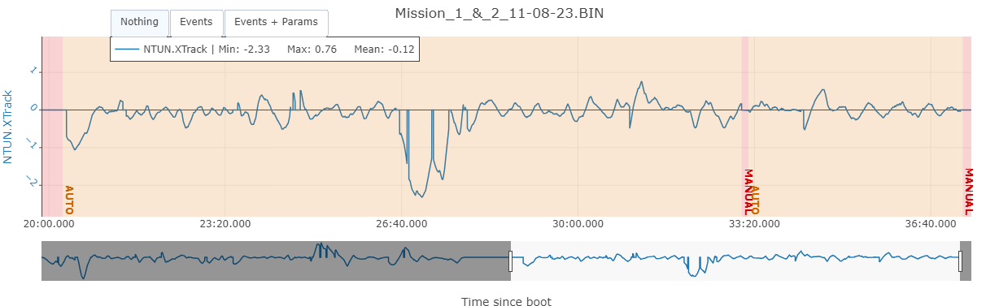
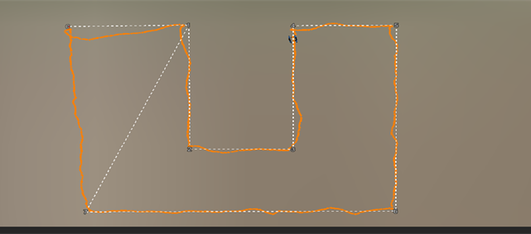
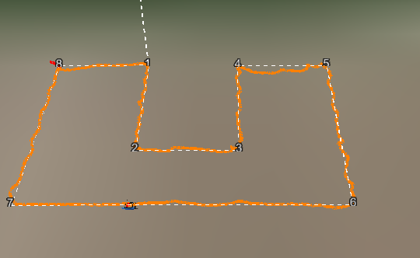

Slide 8
Initial data fixes
PID TUNING
CHANGE RADIUS SIZE WAYPOINT APPROACH
CHANGE OF STEERING RATE
CHANGE TO PIVOT TURNS
RECALIBRATION OF COMPASS
FIX THE INITIAL HOME POINT ALTITUDE POSITION
RE-MAPPED WAYPOINT

Slide 9
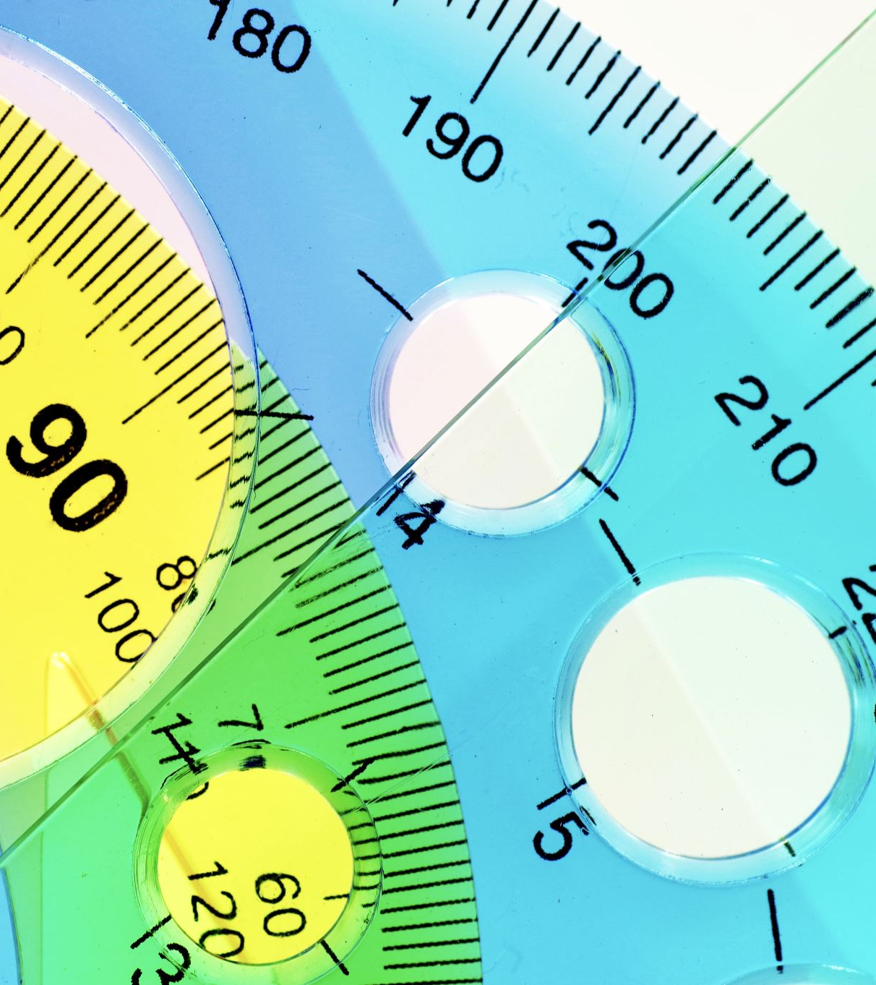
Temperature readings & comparison

Slide 10
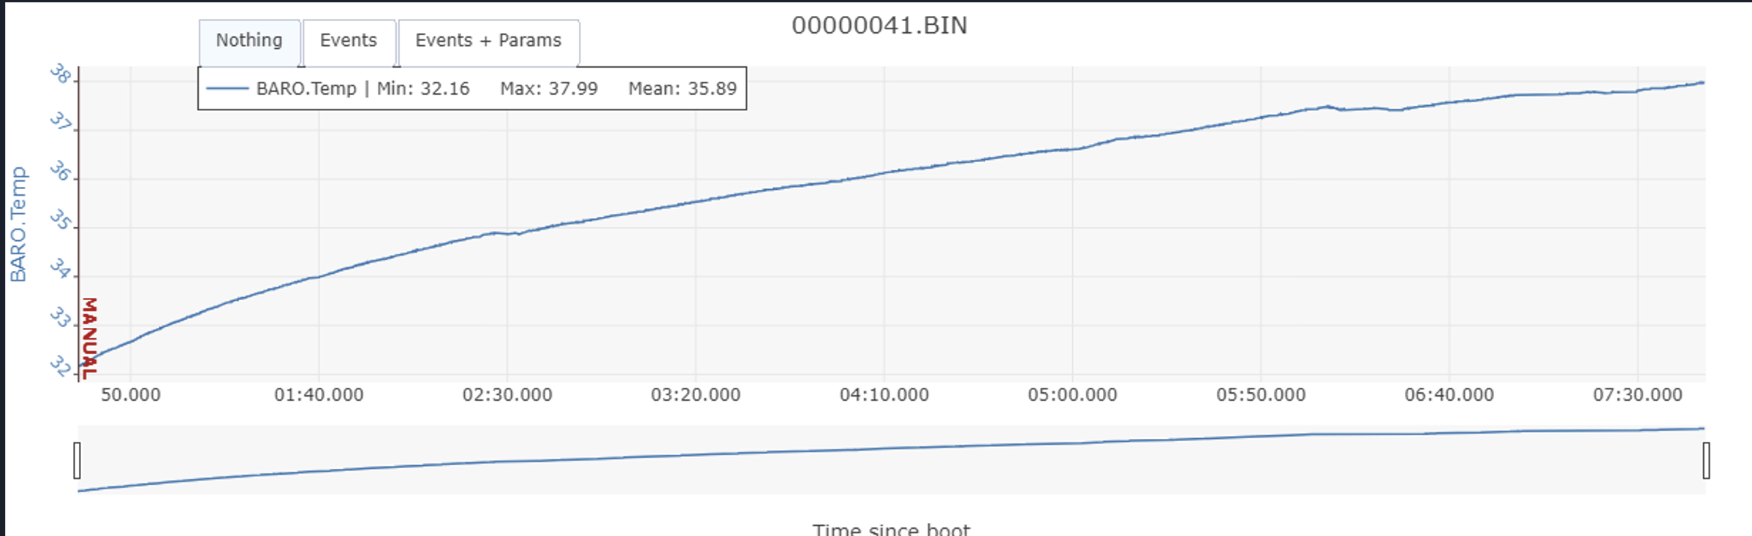
Temperature {PI READINGS}
AVERAGED 35.89 C
OR 96.62 F

Slide 11
Temperature {dht-11 readings}
AVG. EXTERIOR READING {TAKE 1}:
21.52 C
AVG. INTERNAL BATTERY READING {TAKE 1}:
23.7 C
AVG. EXTERIOR READING {TAKE 2}:
18.3 C
AVG. INTERNAL BATTERY READING {TAKE 2}:
22.4 C
INTERIOR MOTOR READING {TAKE 1}:
20.7 C
ACTUAL TEMPERATURE OF MEASURED DAY:
19.44 C
67.0 F
INTERIOR MOTOR READING {TAKE 2}:
21.2 C

Slide 12
Improvements
Greater separation of DHT-11 from the Rover body (3-D printed rod/stand)
Better insulation between inside and outside of the rover
Further testing of the rover and DHT-11 setup in other environments

Slide 13
Conclusion
What was learned
Cooperation in a team and communication with team members
Motor driver inputs
How to utilize a navio2 and raspberry pi
Applications elsewhere
The sensor connections can be used in other builds and other devices and not specific or unique to the rover build.
Communications between devices
How to get systems (Pi, Navio, and Arduino) to communicate and function with one another

Slide 14

THANK YOU!

